Slide 1
DATA ANALYSIS
ZOMATO CHENNAI

Slide 2
About Dataset
This dataset provides information about various restaurants that are registered with Zomato around the Chennai.
Dining rating , Dining rating count , Delivery rating , Delivery rating count ,Address ,city ,top dishes , features , price for 2 and cuisines are the main attributes.
According to the given data:
Dependent variables are : Independent variables are:
Dining rating 1. Address
Dining rating count 2. Location
Delivery rating 3. Cuisine
Delivery rating count
Features
Price for 2

Slide 3
Functions applied:
Select the rows which are invalid and which contains null values ,then click on delete option to obtain the new dataset with no invalid data.
Select the rows such as Dining ratings and Delivery ratings each at a time then click on ctrl + H , a dialog box appears with the text replace, then select the text which needs to be replaced and type the text or any value to be inserted in the that place , at last click on replace all , it will be replaced with the given value.

Slide 4
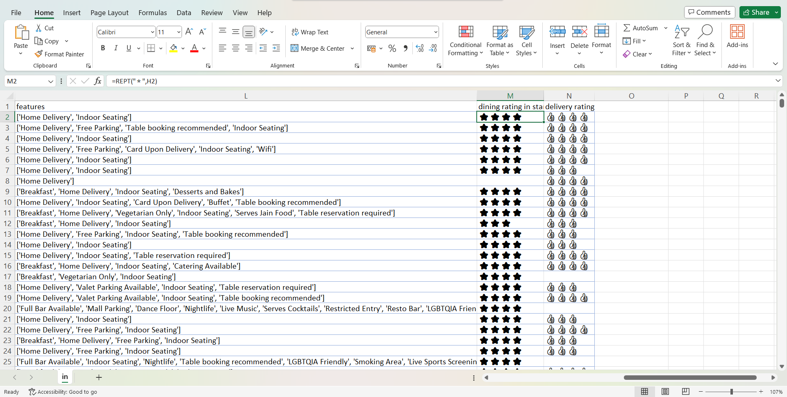
REPT Function
REPT function repeats a given number of times . Use REPT to fill a cell with a number of instances of a text string .
Here dining ratings and delivery ratings are taken as a new column and dining ratings are represented using ⭐ symbol and delivery ratings are represented using 👍symbol using following formula:
=REPT(text ,number _times)
Dining Rating -
=REPT(“⭐”,H2)
Delivery Rating-
=REPT(“👍”,J2)

Slide 5
MIN AND MAX
MAX-Returns the largest value in a set of values . Ignores logical values and text.
MIN-Returns the smallest number in a set of values . Ignores logical values and text.
Maximum and Minimum ratings occurred in Dining ratings-
Maximum and Minimum ratings occurred in Delivery ratings-
Maximum and Minimum reviews count occurred in Dining-
Maximum and Minimum reviews count occurred in Delivery-
=MAX(number1,[number2],..)
=MIN(number1,[number2],…)
=MAX(H2:H8490)
4.9
=MIN(H2:H8490)
0.3
=MAX(J2:J8490)
4.7
=MIN(J2:J8490)
0.3
=MAX(I2:I8490)
9410
=MIN(I2:I8490)
0
=MAX(K2:K8490)
59900
=MIN(K2:K8490)
0

Slide 6
COUNTIF
Counts the number of cells within a range that meet the given condition.
How many restaurants does not offer dining?
How many restaurants have the dish Biryani as their only cuisine?
How many restaurants got 3 as their Dining ratings?
=COUNTIF(range , criteria)
=COUNTIF(I2:I8490,I8)
1553
=COUNTIF(E2:E8490)
136
=COUNTIF(H2:H8490)
302

Slide 7
INDEX and MATCH
INDEX function returns a value or reference of the cell at the intersection of a particular row and column in a given range.
MATCH function returns the relative position of an item in an array that matches a specified value in a specified order.
Which restaurant is with the highest Average cost for two persons?
=INDEX(array , row _ num ,[ column_ num]
=INDEX(reference , row _ num ,[column _ num],area _ num)
=MATCH( lookup _value , lookup _ array,[match _ type])
=INDEX(B2:B8490,MATCH(MAX(G2:G8490),G2:G8490,0))
BLEND-TAJ CLUB HOUSE

Slide 8
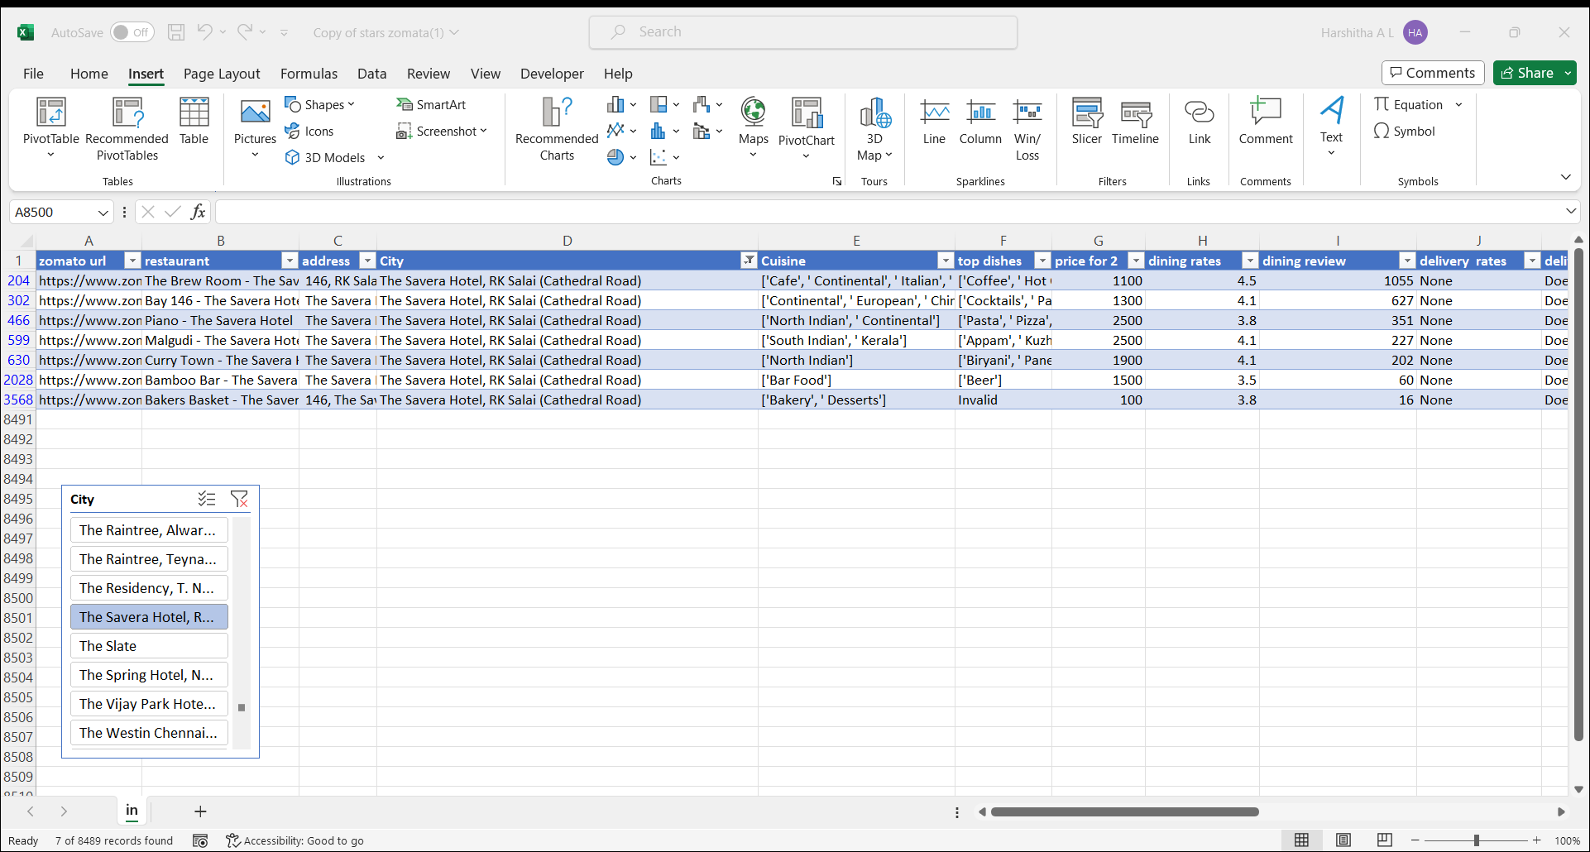
slicers
Slicers provide buttons that you can click to filter tables
In addition to quick filtering, slicers also indicate the current filtering state, which makes it easy to understand what exactly is currently displayed. You can use a slicer to filter data in a table or PivotTable with ease.

Slide 9
SUMIF Adds the cell based on given condition or criteria
=SUMIF(range ,criteria,[sum range])
1.How many dining reviews KFC got in all over Chennai?
=SUMIF(B2:B8940,”KFC”,I2:I840) =16049
2.How many dining reviews Pallaravam city has got?
=SUMIF(D2:D8940,D2,I2:8940) =10085
3.How many delivery reviews Alandur city has got?
=SUMIF(D2:D8940,D3,K2:K8940) =55262
4.How many delivery reviews Tast Kitchen got in all over Chennai?
=SUMIF(B2:B8940,”Tasty Kitchen”,K2:K8940) =168106

Slide 10
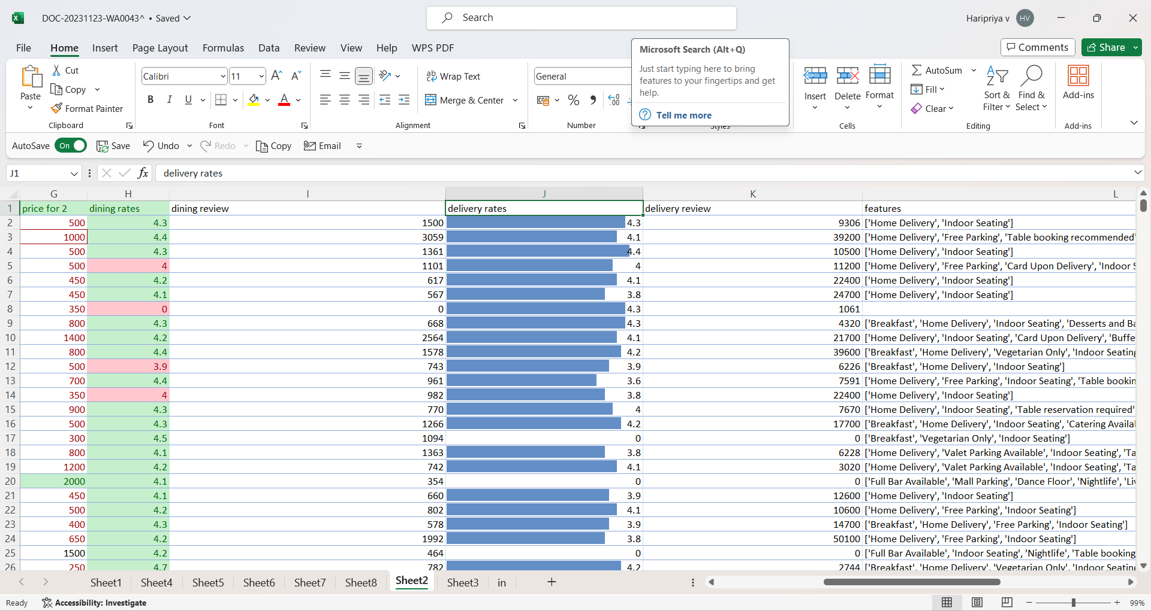
CONDITIONAL FORMATTING;
Makes it easy to highlight certain values or make particular cells very easy to identify
Here in our Data set we have used Conditional Formatting function and we have highlighted Dining Rates rows…..RED colour indicates rating less than 4 and GREEN Colour indicates rating more than 4.
For Delivery Rates Column we have used Data Bars in that Solid Fill so that we can identify the ratings easily

